Slide 1
Divide and Conquer
分解征服法(分治法)

Slide 2
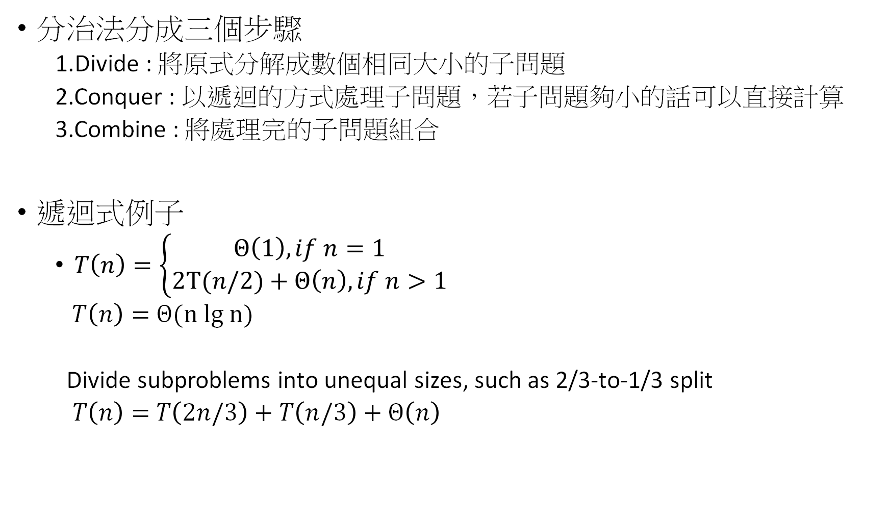
分治法分成三個步驟
1.Divide : 將原式分解成數個相同大小的子問題
2.Conquer : 以遞迴的方式處理子問題，若子問題夠小的話可以直接計算
3.Combine : 將處理完的子問題組合
遞迴式例子
$T\left(n\right)=\left\{\begin{aligned}Θ\left(1\right),if n=1 \\ 2T(n/2)+Θ\left(n\right)&,if n>1\end{aligned}\right.$
$T\left(n\right)=$ $Θ(n lg n)$
Divide subproblems into unequal sizes, such as 2/3-to-1/3 split
$T\left(n\right)=$ $T\left(2n/3\right)+T\left(n/3\right)+$ $Θ\left(n\right)$

Slide 3
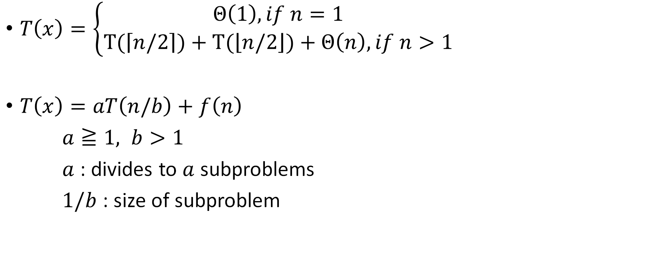
$T\left(x\right)=\left\{\begin{aligned}Θ\left(1\right),if n=1 \\ T(\left\lceil n\right.\left./2\right\rceil )+T(\left\lfloor n\right.\left./2\right\rfloor )+Θ\left(n\right)&,if n>1\end{aligned}\right.$
$T\left(x\right)=aT\left(n/b\right)+f\left(n\right)$
$a≧1, b>1$
$a$ : divides to $a$ subproblems
$1/b$ : size of subproblem

Slide 4
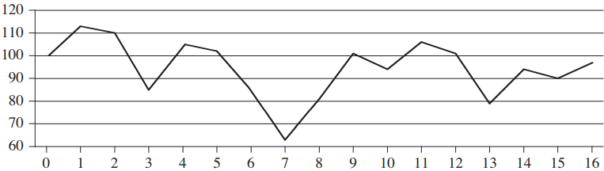

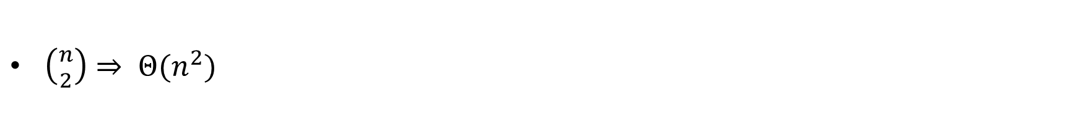
4-1 The maximum-subarray problem
$\left({n \atop 2}\right)⇒ Θ(n^{2})$

Slide 5
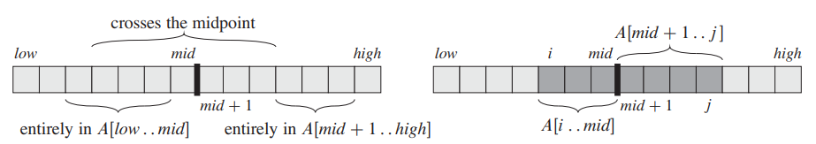
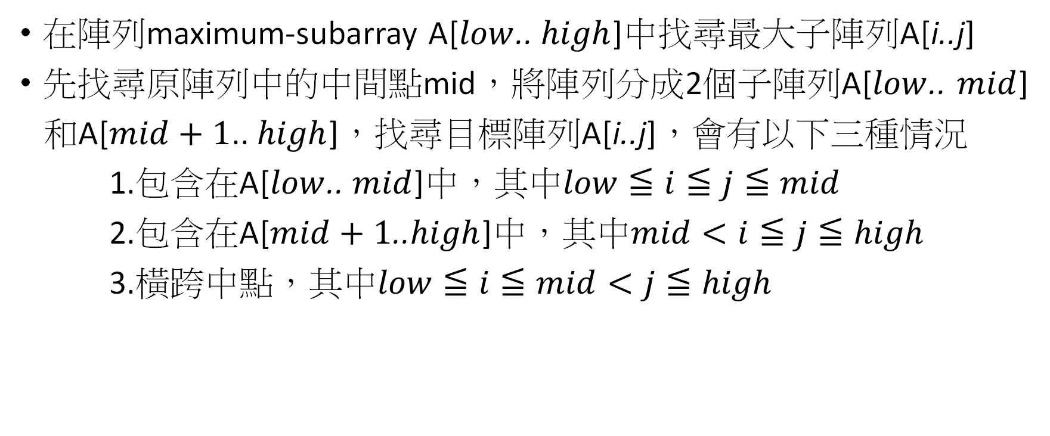
A solution using divide-and-conquer
在陣列maximum-subarray A[$low$.. $high$]中找尋最大子陣列A[i..j]
先找尋原陣列中的中間點mid，將陣列分成2個子陣列A[$low$.. $mid$]
和A[$mid+1$.. $high$]，找尋目標陣列A[i..j]，會有以下三種情況
1.包含在A[$low$.. $mid$]中，其中$low≦i≦j≦mid$
2.包含在A[$mid+1$..$high$]中，其中$mid<i≦j≦high$
3.橫跨中點，其中$low≦i≦mid<j≦high$

Slide 6
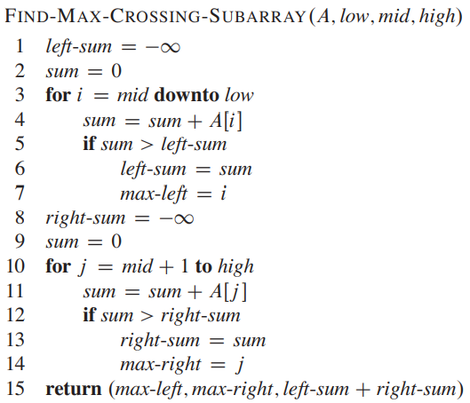

Slide 7
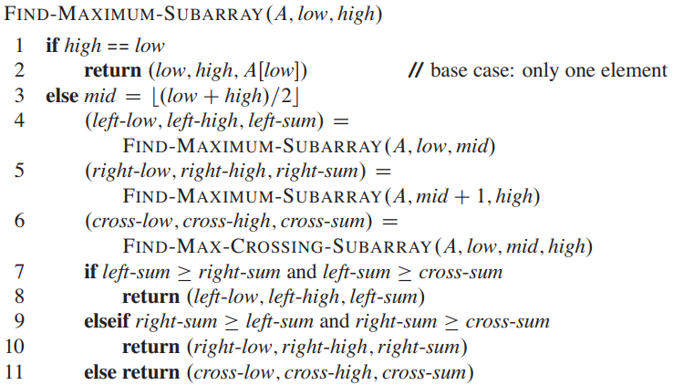





$$Θ(1)$$
$$T(n/2)$$
$$T(n/2)$$
$$Θ(n)$$
$$Θ(1)$$

Slide 8

Analyzing the divide-and-conquer algorithm
假設$T\left(n\right)$為陣列中有n個元素時的時間複雜度
$T\left(1\right)=Θ\left(1\right)$
$T\left(n\right)=Θ\left(1\right)+2T\left(n/2\right)+Θ\left(n\right)+Θ\left(1\right)$
$=2T\left(n/2\right)+Θ\left(n\right)$
$T\left(n\right)=\left\{\begin{aligned}Θ\left(1\right),if n=1 \\ 2T(n/2)+Θ\left(n\right)&,if n>1\end{aligned}\right.$
$T\left(n\right)=$ $Θ(n lg n)$

Slide 9
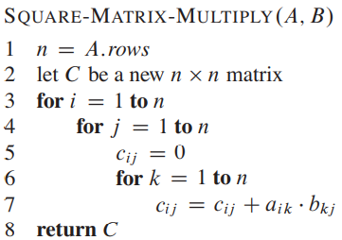

4-2 Strassen’s algorithm for matrix multiplication
$A=\left(a_{ij}\right)$and $B=\left(b_{ij}\right)$, both A and B are $n×n$ matrix
$C=A∙B$, define $c_{ij}$ for $i,j=1,2,…,n$ by
$c_{ij}=\sum_{k=1}^{n}{a_{ik}∙b_{kj}}$
running time $Θ(n^{3})$

Slide 10
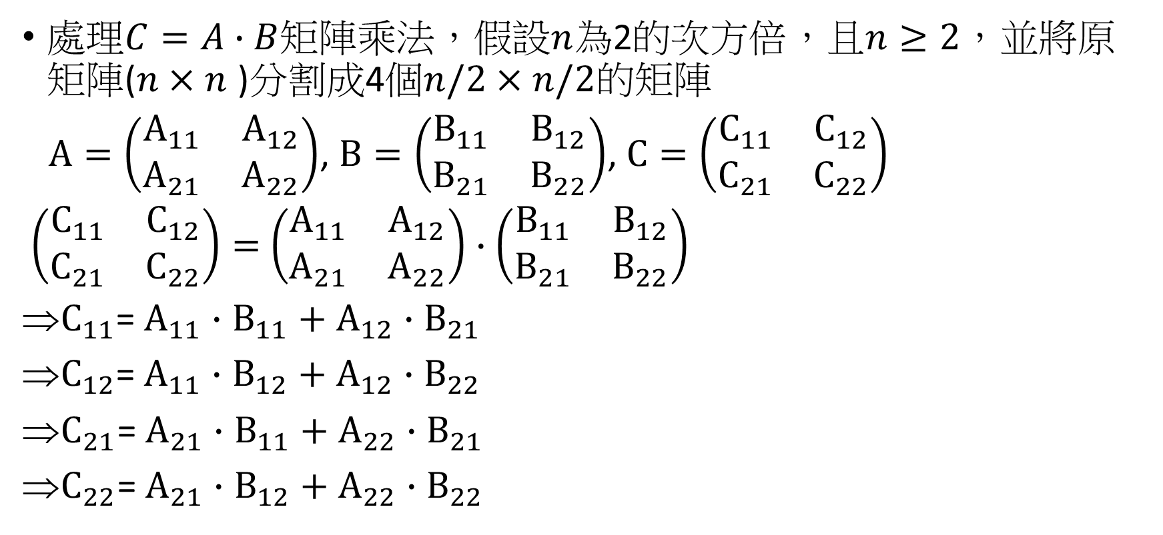
Divide and conquer for matrix
處理$C=A∙B$矩陣乘法，假設$n$為2的次方倍，且$n≥2$，並將原矩陣($n×n$ )分割成4個$n/2×n/2$的矩陣
$A=\left(\begin{matrix}A_{11} & A_{12} \\ A_{21} & A_{22}\end{matrix}\right)$, $B=\left(\begin{matrix}B_{11} & B_{12} \\ B_{21} & B_{22}\end{matrix}\right)$, $C=\left(\begin{matrix}C_{11} & C_{12} \\ C_{21} & C_{22}\end{matrix}\right)$
$\left(\begin{matrix}C_{11} & C_{12} \\ C_{21} & C_{22}\end{matrix}\right)=$ $\left(\begin{matrix}A_{11} & A_{12} \\ A_{21} & A_{22}\end{matrix}\right)∙$ $\left(\begin{matrix}B_{11} & B_{12} \\ B_{21} & B_{22}\end{matrix}\right)$
$C_{11}$= $A_{11}∙$ $B_{11}+$ $A_{12}∙$ $B_{21}$
$C_{12}$= $A_{11}∙$ $B_{12}+$ $A_{12}∙$ $B_{22}$
$C_{21}$= $A_{21}∙$ $B_{11}+$ $A_{22}∙$ $B_{21}$
$C_{22}$= $A_{21}∙$ $B_{12}+$ $A_{22}∙$ $B_{22}$

Slide 11
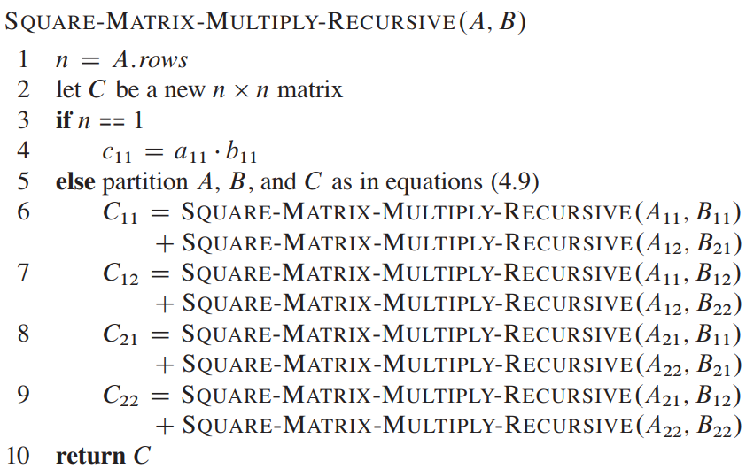



$$Θ(1)$$
$$8T(n/2)$$
+
$$Θ(n^{2})$$

Slide 12
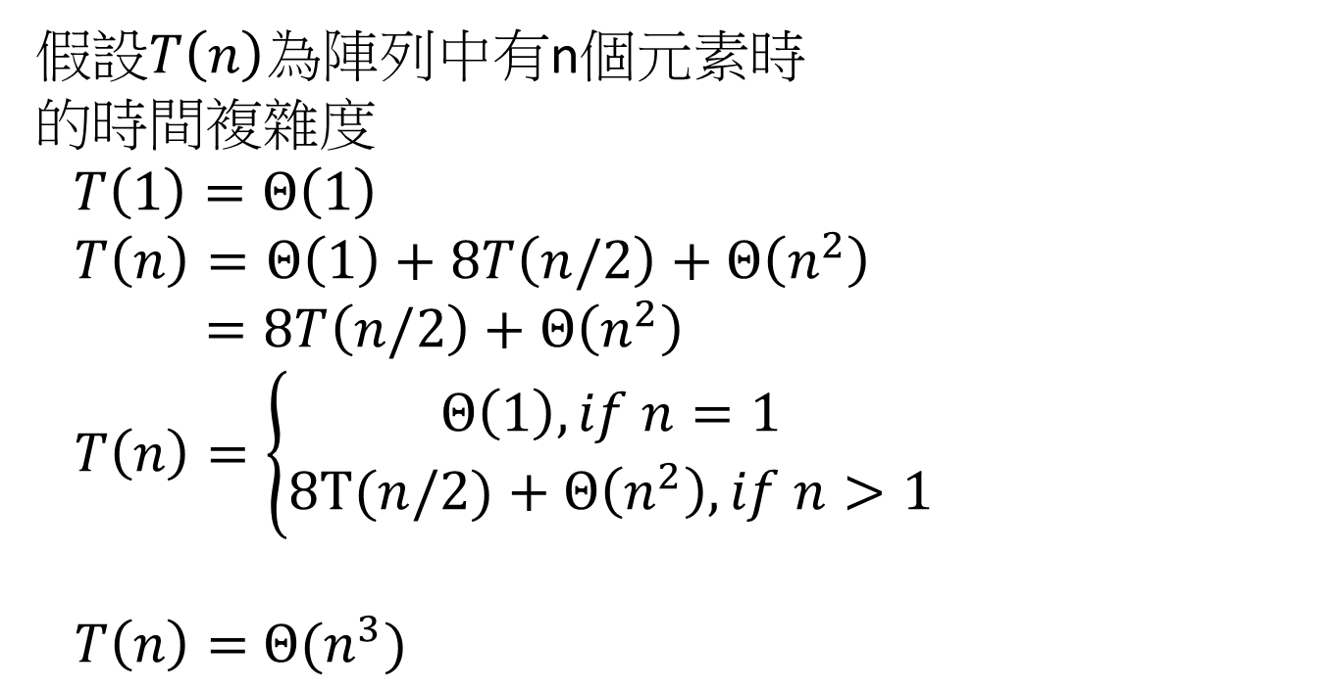
假設$T\left(n\right)$為陣列中有n個元素時
的時間複雜度
$T\left(1\right)=Θ\left(1\right)$
$T\left(n\right)=Θ\left(1\right)+8T\left(n/2\right)+Θ\left(n^{2}\right)$
$=8T\left(n/2\right)+Θ\left(n^{2}\right)$
$T\left(n\right)=\left\{\begin{aligned}Θ\left(1\right),if n=1 \\ 8T(n/2)+Θ\left(n^{2}\right)&,if n>1\end{aligned}\right.$
$T\left(n\right)=$ $Θ(n^{3})$

Slide 13

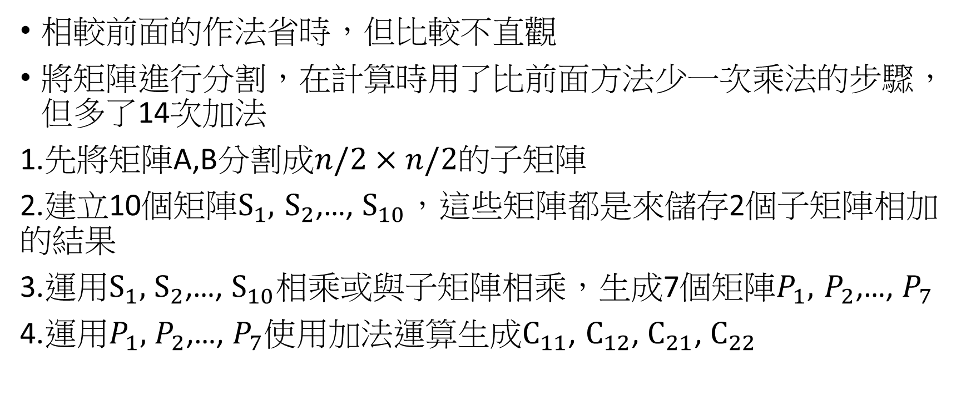
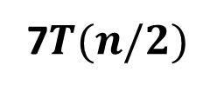
Strassen’s method
相較前面的作法省時，但比較不直觀
將矩陣進行分割，在計算時用了比前面方法少一次乘法的步驟，但多了14次加法
1.先將矩陣A,B分割成$n/2×n/2的子矩陣$
2.建立10個矩陣$S_{1},$ $S_{2}$,…, $S_{10}，$這些矩陣都是來儲存2個子矩陣相加 的結果
3.運用$S_{1},$ $S_{2}$,…, $S_{10}相乘或與$子矩陣相乘，生成7個矩陣$P_{1},$ $P_{2}$,…, $P_{7}$
4.運用$P_{1},$ $P_{2}$,…, $P_{7}$使用加法運算生成$C_{11}$, $C_{12}$, $C_{21}$, $C_{22}$
7$T(n/2)$
$$Θ(n^{2})$$

Slide 14
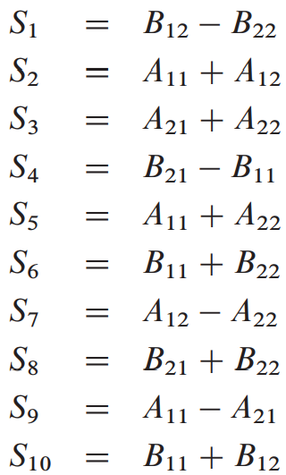
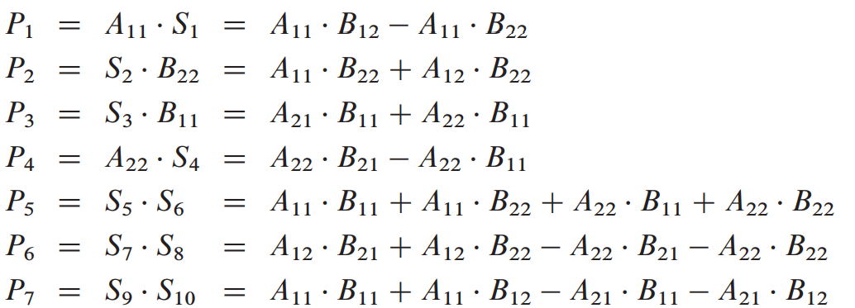
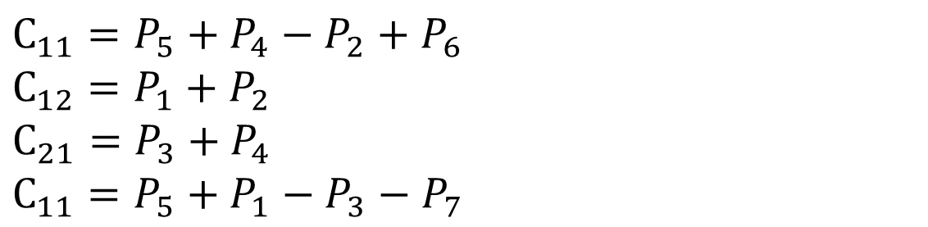
$$C_{11}=P_{5}+P_{4}−P_{2}+P_{6}$$
$$C_{12}=P_{1}+P_{2}$$
$$C_{21}=P_{3}+P_{4}$$
$$C_{11}=P_{5}+P_{1}−P_{3}−P_{7}$$

Slide 15
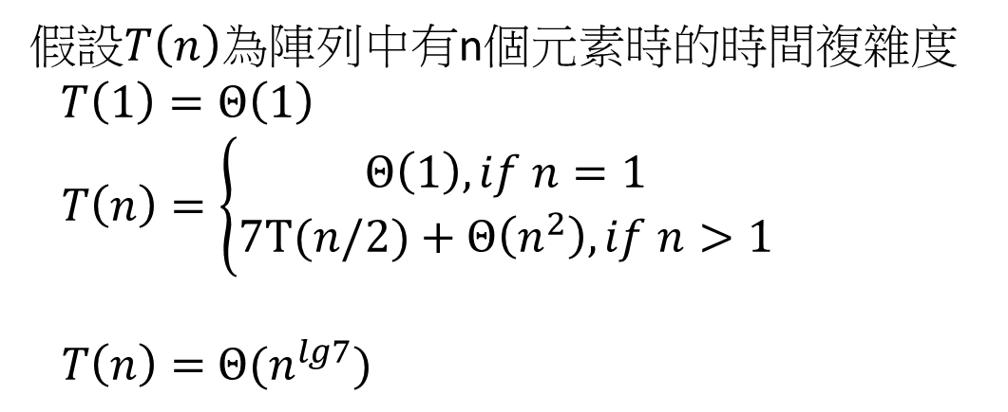
時間複雜度
假設$T\left(n\right)$為陣列中有n個元素時的時間複雜度
$T\left(1\right)=Θ\left(1\right)$
$T\left(n\right)=\left\{\begin{aligned}Θ\left(1\right),if n=1 \\ 7T(n/2)+Θ\left(n^{2}\right)&,if n>1\end{aligned}\right.$
$T\left(n\right)=$ $Θ(n^{lg7})$

Slide 16
4-3 The substitution method for solving recurrences
取代法步驟
1.猜測其解
2.運用數學歸納法驗證猜測是否正確

Slide 17

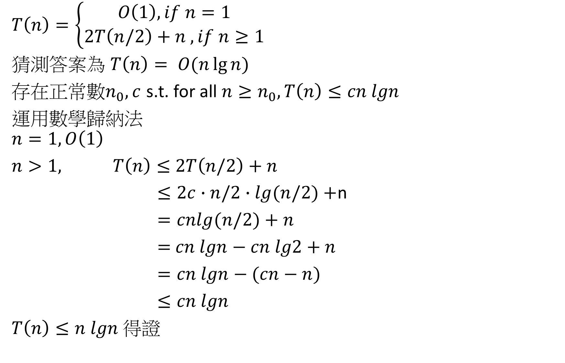
$$T\left(n\right)=\left\{\begin{aligned}O\left(1\right), if n=1 \\ 2T\left(n/2\right)+n , if n≥1\end{aligned}\right.$$
猜測答案為 $T\left(n\right)= O(n\lg{n})$
存在正常數$n_{0}, c$ s.t. for all ${n≥n}_{0}, T\left(n\right)≤cn lgn$
運用數學歸納法
$$n=1, O\left(1\right)$$
$n>1,$ $T\left(n\right)≤$ $2T\left(n/2\right)+n$
$≤2c∙n/2∙lg(n/2)+$n
$=cnlg(n/2)+n$
$=$ $cn lgn−cn lg2+n$
$=cn lgn−(cn−n)$
$≤cn lgn$
$T\left(n\right)≤n lgn$ 得證
By inductive hypothesis
$$cn−n≥0$$

Slide 18
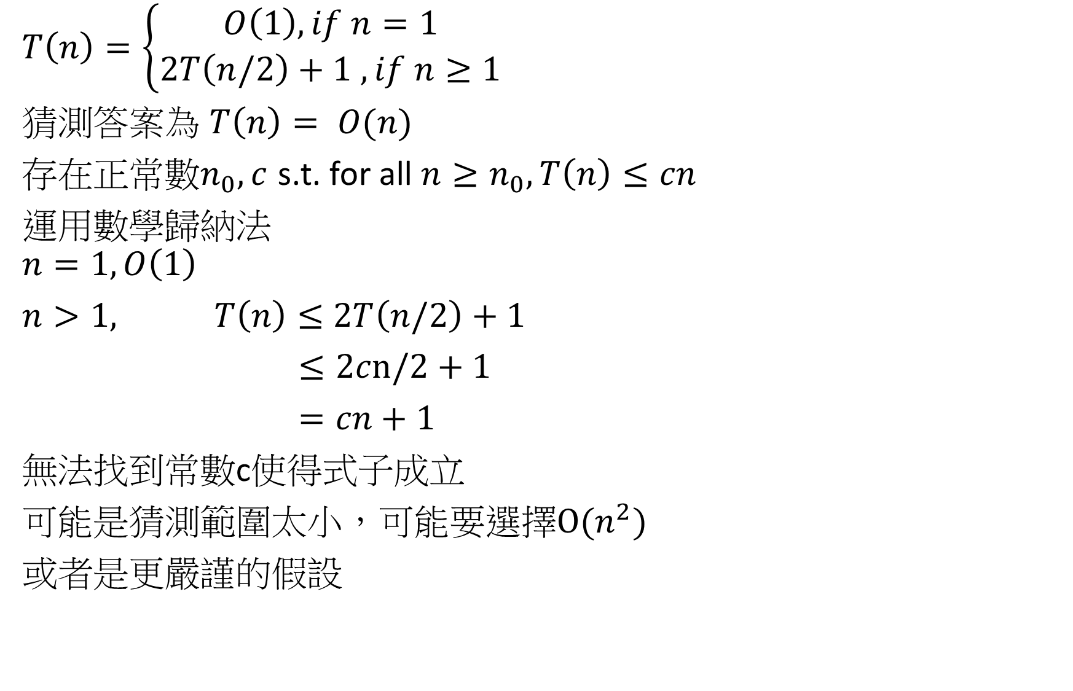
$$T\left(n\right)=\left\{\begin{aligned}O\left(1\right), if n=1 \\ 2T\left(n/2\right)+1 , if n≥1\end{aligned}\right.$$
猜測答案為 $T\left(n\right)= O(n)$
存在正常數$n_{0}, c$ s.t. for all ${n≥n}_{0}, T\left(n\right)≤cn$
運用數學歸納法
$$n=1, O\left(1\right)$$
$n>1,$ $T\left(n\right)≤$ $2T\left(n/2\right)+1$
$≤2cn/2+1$
$=cn+1$
無法找到常數c使得式子成立
可能是猜測範圍太小，可能要選擇${O(n}^{2})$
或者是更嚴謹的假設

Slide 19
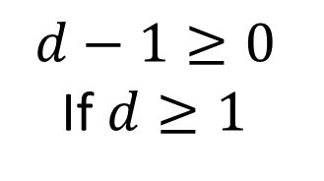
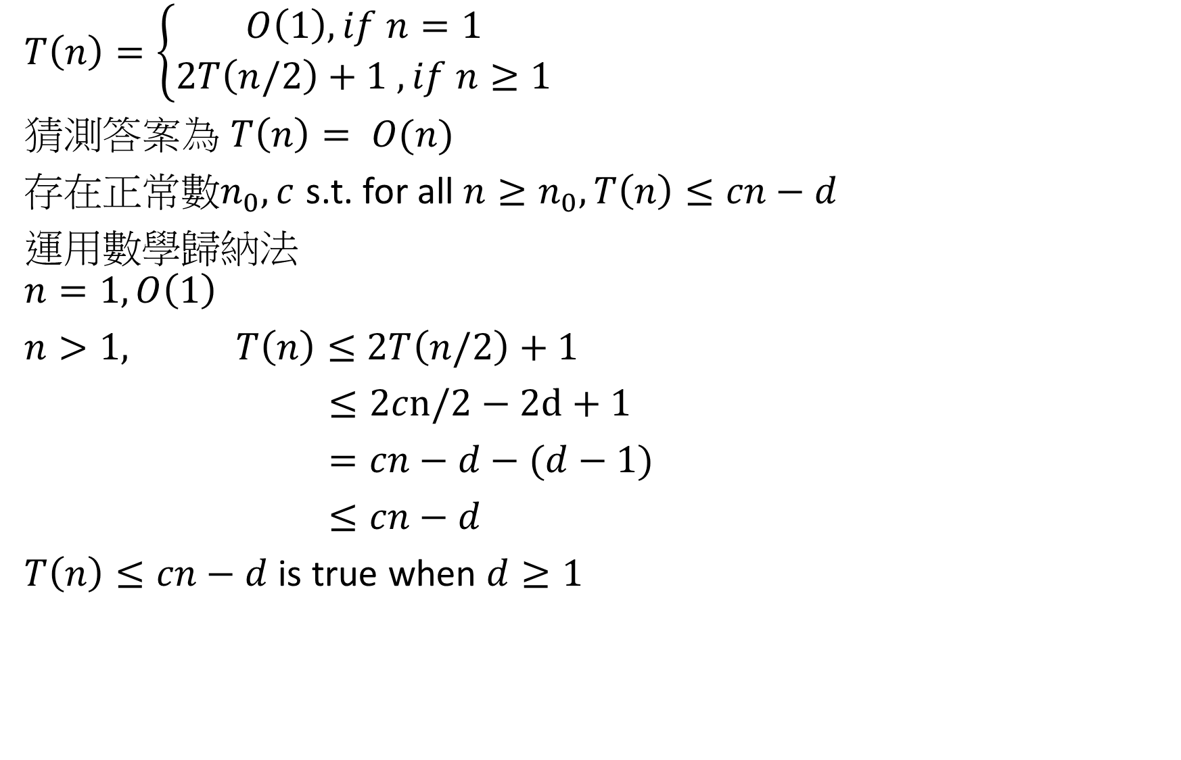
$$T\left(n\right)=\left\{\begin{aligned}O\left(1\right), if n=1 \\ 2T\left(n/2\right)+1 , if n≥1\end{aligned}\right.$$
猜測答案為 $T\left(n\right)= O(n)$
存在正常數$n_{0}, c$ s.t. for all ${n≥n}_{0}, T\left(n\right)≤cn−d$
運用數學歸納法
$$n=1, O\left(1\right)$$
$n>1,$ $T\left(n\right)≤$ $2T\left(n/2\right)+1$
$≤2cn/2−2d+1$
$=cn−d−(d−1)$
$≤cn−d$
$T\left(n\right)≤cn−d$ is true when $d≥1$
$$d−1≥0$$
If $d≥1$

Slide 20
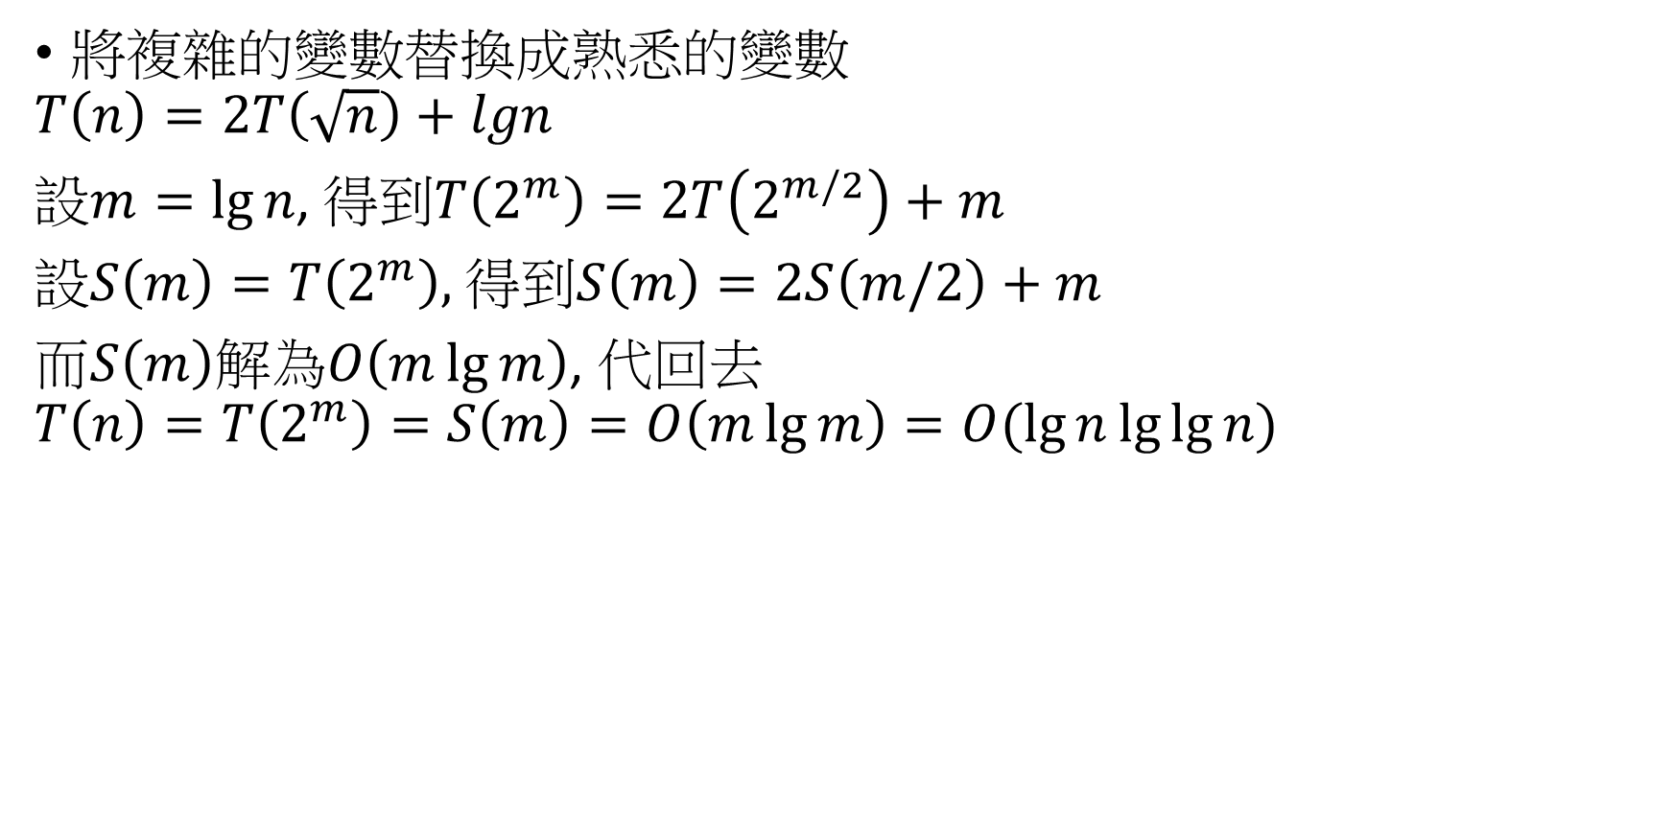
Changing variable
將複雜的變數替換成熟悉的變數
$$T\left(n\right)=2T\left(\sqrt{n}\right)+lgn$$
設$m=\lg{n}$, 得到$T\left(2^{m}\right)=2T\left(2^{m/2}\right)+m$
設$S\left(m\right)=T\left(2^{m}\right),$得到$S\left(m\right)=2S\left(m/2\right)+m$
而$S\left(m\right)$解為$O\left(m\lg{m}\right)$, 代回去
$$T\left(n\right)=T\left(2^{m}\right)=S\left(m\right)=O\left(m\lg{m}\right)=O(\lg{n\lg{\lg{n}}})$$

Slide 21
4-4 The recursion-tree method for solving recurrence
目的:利用recursion-tree分析出可能的時間複雜度，再使用substitution method驗證
在substitution method中，我們用歸納法證明猜測的上界是否正確
recursion-tree中每個節點定義為每個子問題的成本

Slide 22
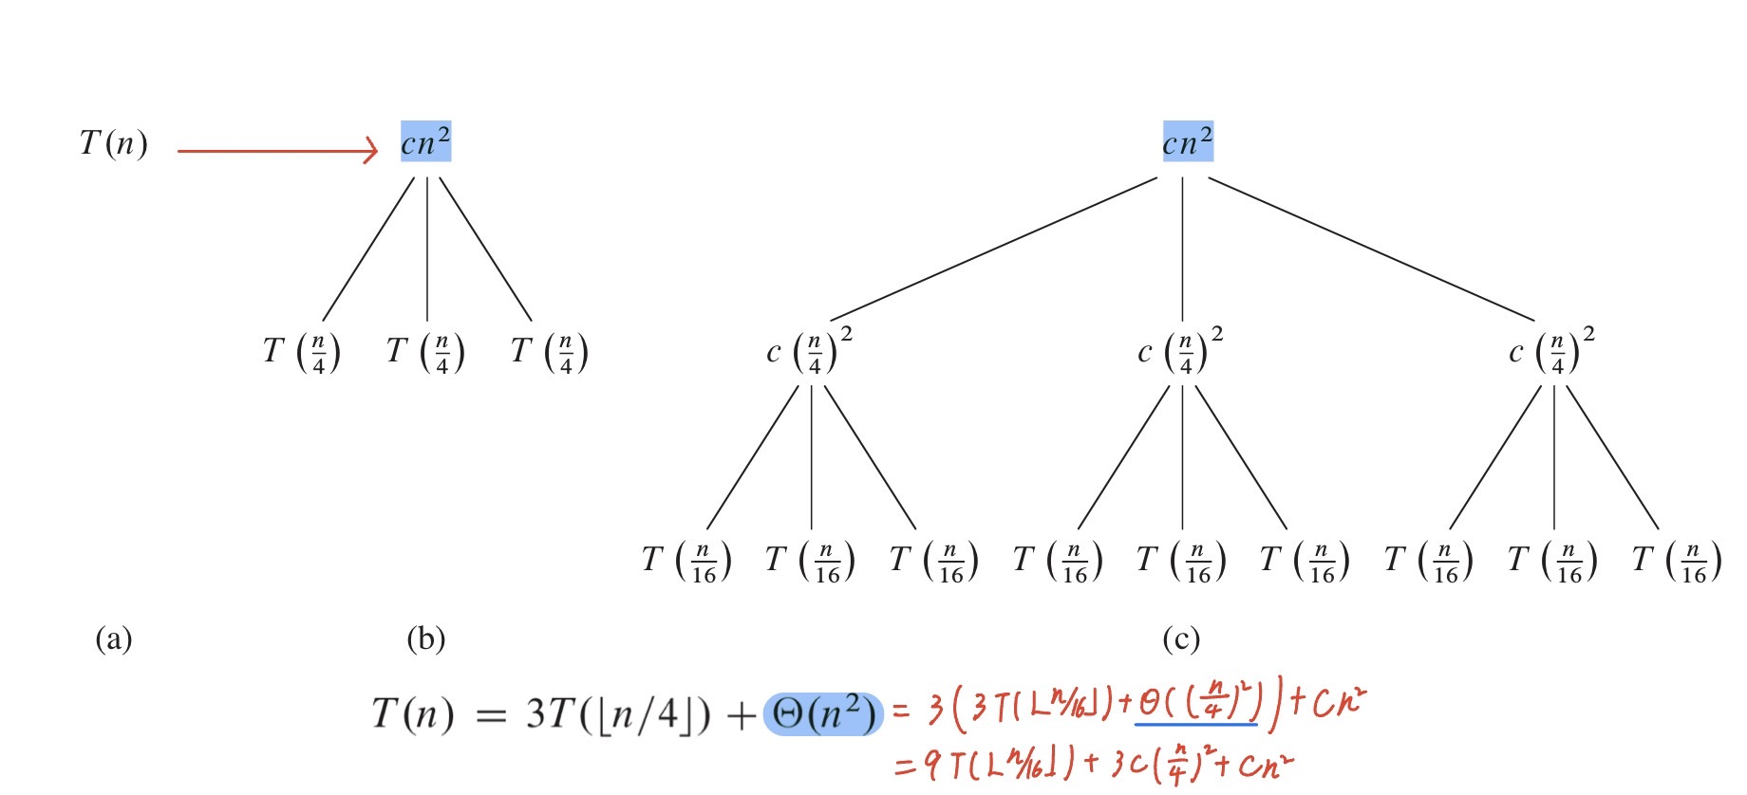
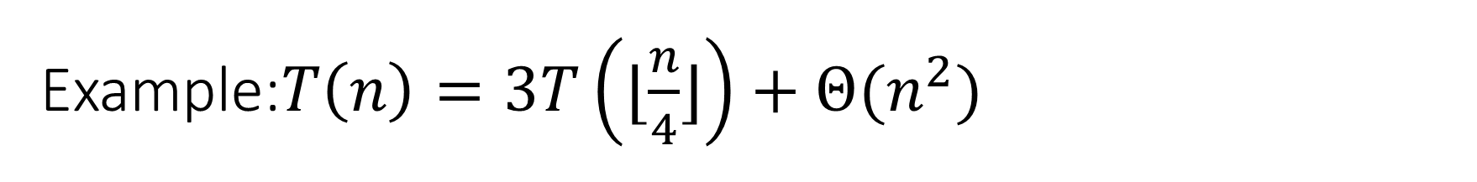
Example:$T\left(n\right)=3T\left(⌊\frac{n}{4}⌋\right)+Θ(n^{2})$
Step 1: 利用recursion-tree得出時間複雜度
假設n是4的次方(所有子問題大小都是整數)
可以將(a)延伸為(b)

Slide 23
Example:$T\left(n\right)=3T\left(⌊\frac{n}{4}⌋\right)+Θ(n^{2})$

Slide 24
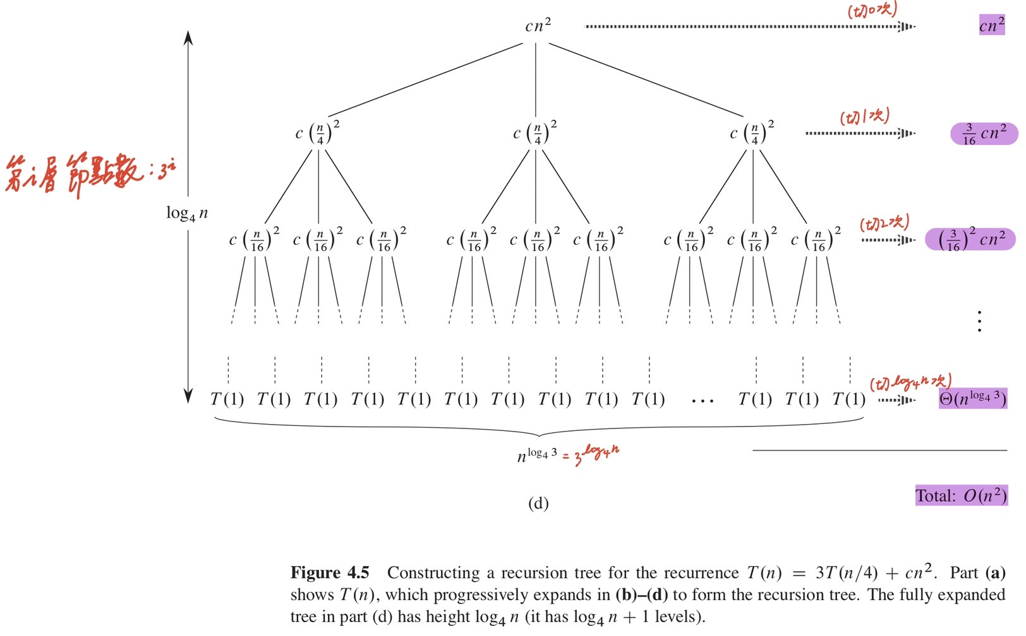

葉節點數量為$3^{\log_{4}{n}}$= $n^{\log_{4}{3}}$

Slide 25
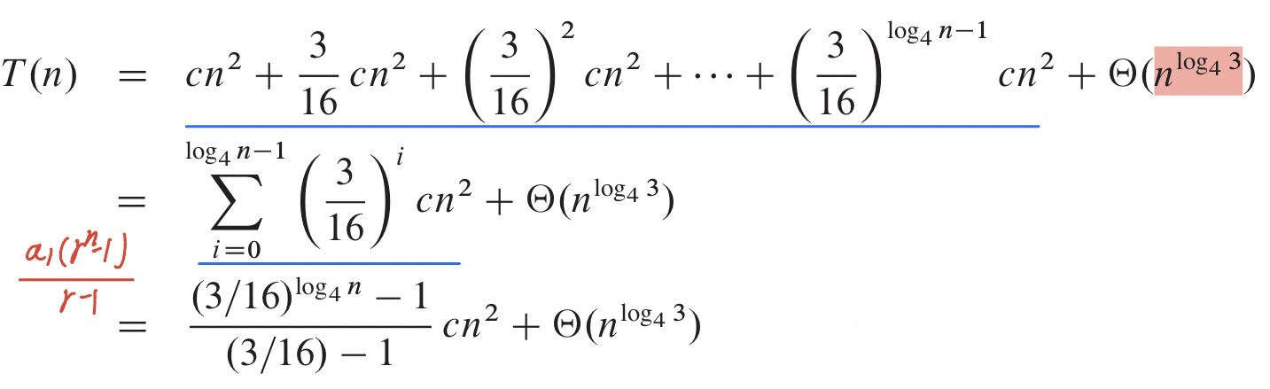
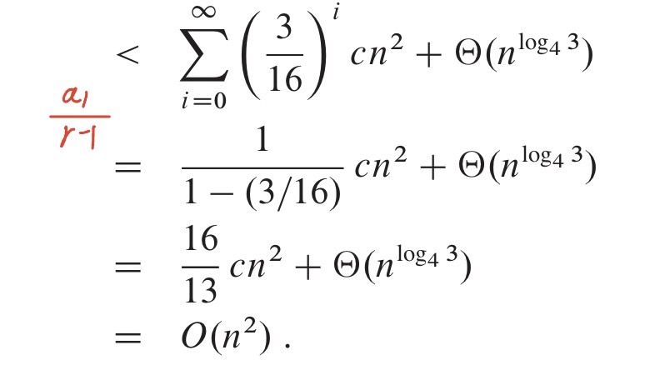

Example:$T\left(n\right)=3T\left(⌊\frac{n}{4}⌋\right)+Θ(n^{2})$
利用recursion-tree得出$T\left(n\right)\text{∈}O(n^{2})$

Slide 26
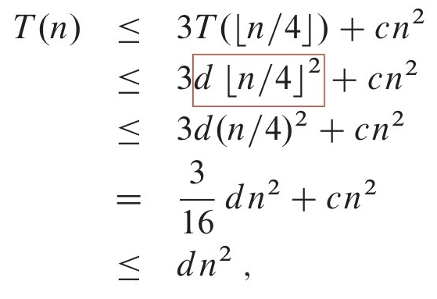


Example:$T\left(n\right)=3T\left(⌊\frac{n}{4}⌋\right)+Θ(n^{2})$
因為根節點的成本為$cn^{2}，$所以$T\left(n\right)\text{∈}Ω(n^{2})$
Step 2: 利用substitution method驗證$T\left(n\right)\text{∈}O\left(n^{2}\right)$
$∵T\left(n\right)\text{∈}O\left(n^{2}\right) ∴T\left(n\right)≤dn^{2}, d>0$
$$d≥\left(\frac{16}{13}\right)c$$

Slide 27
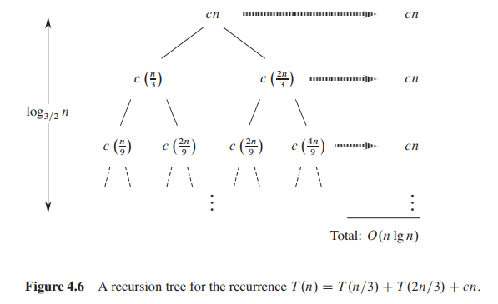
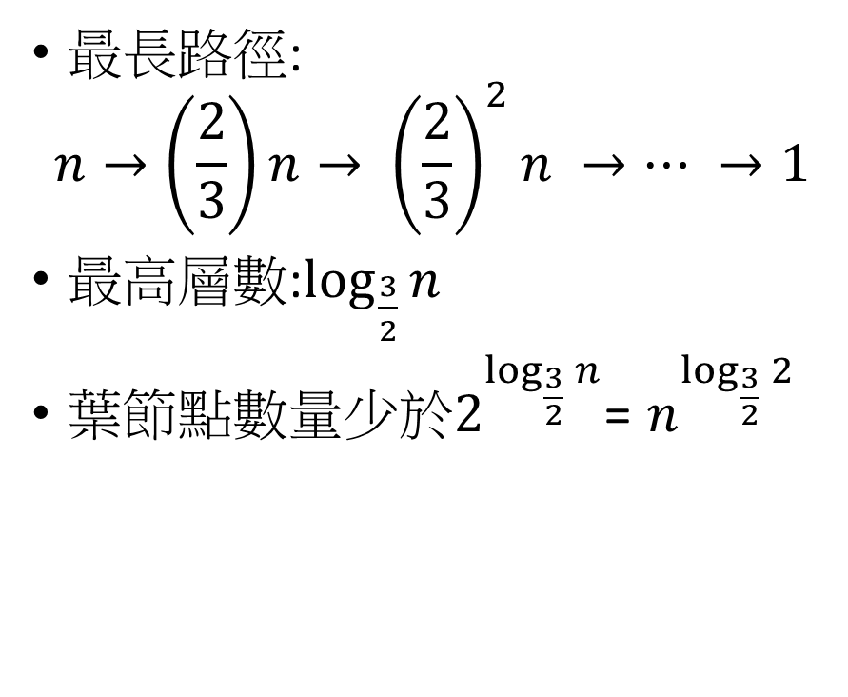
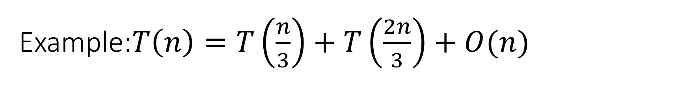
Example:$T\left(n\right)=T\left(\frac{n}{3}\right)+T\left(\frac{2n}{3}\right)+O(n)$
最長路徑:
$$n→\left(\frac{2}{3}\right)n→ {\left(\frac{2}{3}\right)}^{2}n →… →1$$
最高層數:$\log_{\frac{3}{2}}{n}$
葉節點數量少於$2^{\log_{\frac{3}{2}}{n}}$= $n^{\log_{\frac{3}{2}}{2}}$

Slide 28
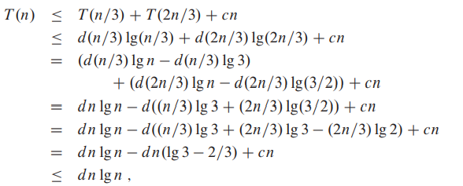
Example:$T\left(n\right)=T\left(\frac{n}{3}\right)+T\left(\frac{2n}{3}\right)+O(n)$

Slide 29

4-5 The master method for solving recurrences
Master Theorem 在解決:
將$T\left(n\right)切成a$個大小為$\frac{n}{b}$的子問題，每個子問題花費$T\left(\frac{n}{b}\right)$
$T\left(n\right)=aT\left(\frac{n}{b}\right)+f\left(n\right),$ $a≥1,b>1,f\left(n\right) is a function of n$

Slide 30
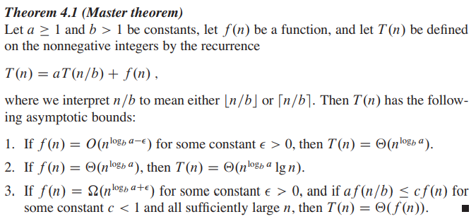
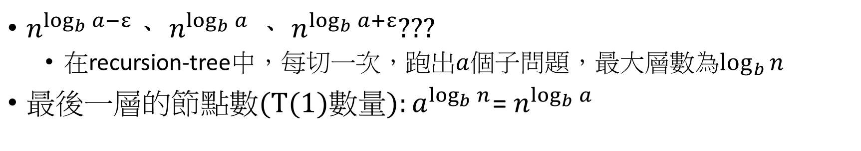
Master Theorem
因為等號右邊有2部分，所以較大的部分決定了上界
$n^{\log_{b}{a−ε}}$、 $n^{\log_{b}{a}}$、 $n^{\log_{b}{a+ε}}$???
在recursion-tree中，每切一次，跑出$a$個子問題，最大層數為$\log_{b}{n}$
${最後一層的節點數(T(1)數量):a}^{\log_{b}{n}}$= $n^{\log_{b}{a}}$

Slide 31

Master Theorem−case 1
$T\left(n\right)=aT\left(\frac{n}{b}\right)+f\left(n\right)$
$n^{\log_{b}{a−ε}}=$ $n^{\log_{b}{a}}÷$ $n^{ε}$
$\frac{f(n)}{n^{\log_{b}{a}}}=O(n^{−ε})$
$n^{\log_{b}{a}}較f\left(n\right)大(差距n^{ε}倍)$，所以$T\left(n\right)=Θ(n^{\log_{b}{a}})$

Slide 32
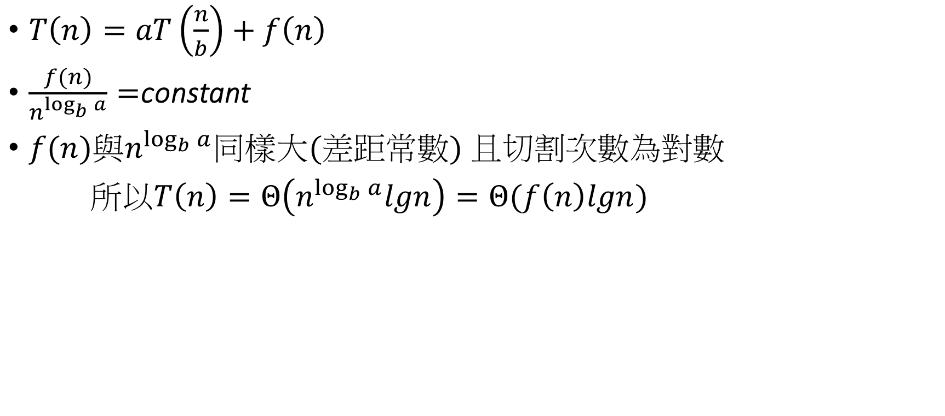
Master Theorem − case 2
$T\left(n\right)=aT\left(\frac{n}{b}\right)+f\left(n\right)$
$\frac{f(n)}{n^{\log_{b}{a}}}=$constant
$f(n)與n^{\log_{b}{a}}同樣大(差距常數)$且切割次數為對數
所以$T\left(n\right)=Θ\left(n^{\log_{b}{a}}lgn\right)=Θ(f\left(n\right)lgn)$

Slide 33
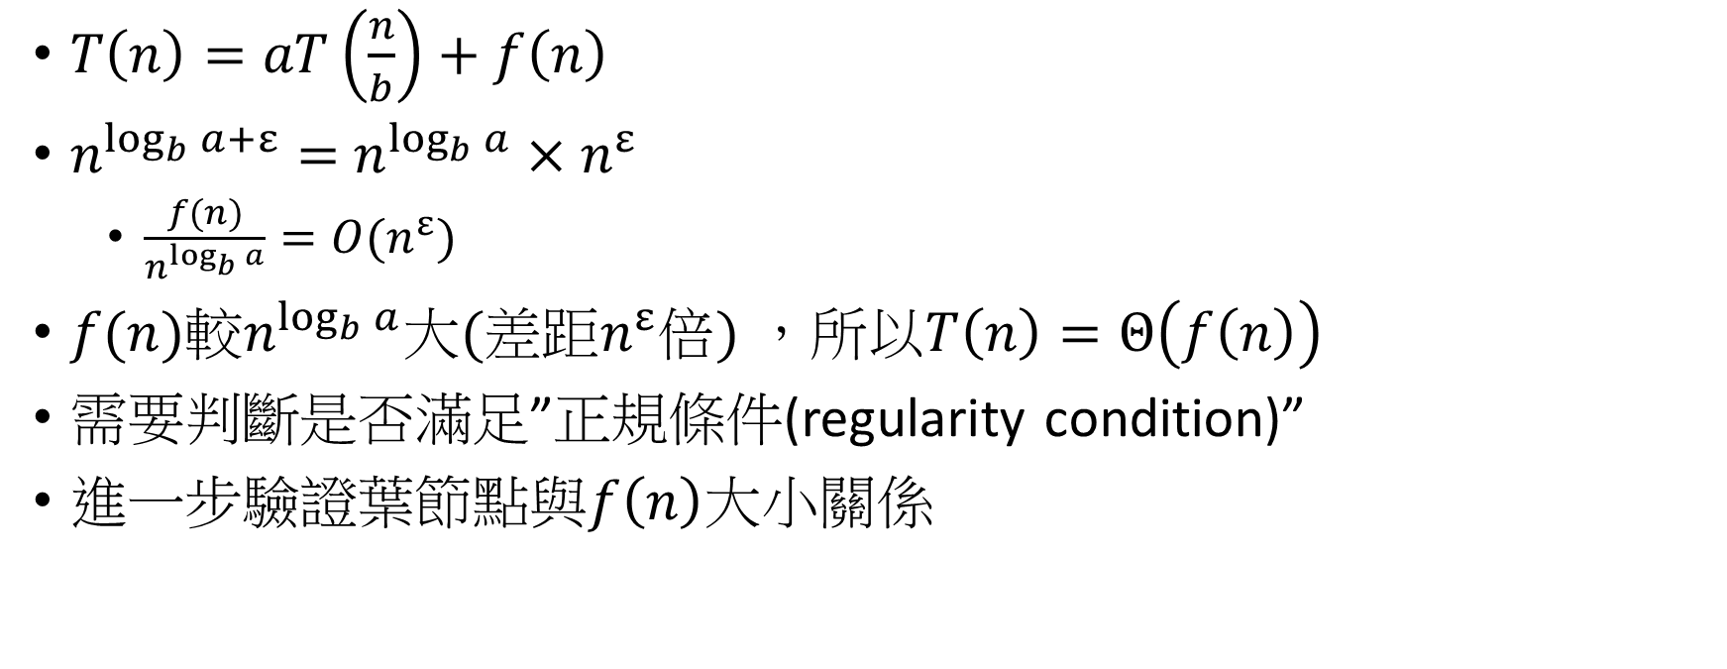
Master Theorem − case 3
$T\left(n\right)=aT\left(\frac{n}{b}\right)+f\left(n\right)$
$n^{\log_{b}{a+ε}}=$ $n^{\log_{b}{a}}×n^{ε}$
$\frac{f(n)}{n^{\log_{b}{a}}}=O(n^{ε})$
$f(n)較n^{\log_{b}{a}}大(差距n^{ε}倍)$，所以$T\left(n\right)=Θ\left(f\left(n\right)\right)$
需要判斷是否滿足”正規條件(regularity condition)”
進一步驗證$葉節點與f\left(n\right)$大小關係

Slide 34

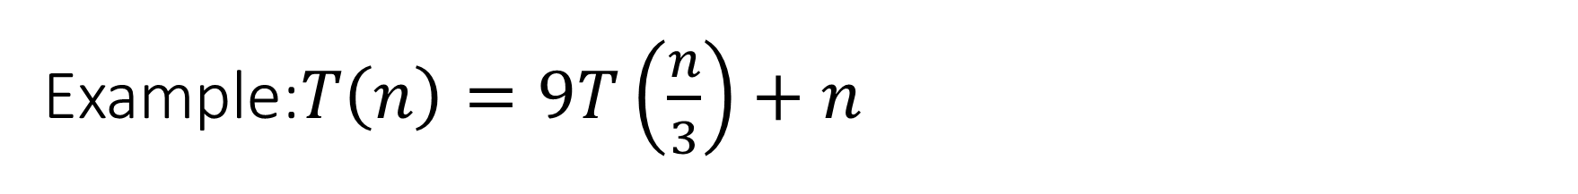
Example:$T\left(n\right)=9T\left(\frac{n}{3}\right)+n$
$a=9,b=3,f\left(n\right)=n$
$n^{\log_{b}{a}}=$ $n^{\log_{3}{9}}=$ $Θ(n^{2})$
$f\left(n\right)=n=O(n^{\log_{3}{9}−ε})$ $=O(n^{2−ε})$
$∃ε=1 ⇒$ $T\left(n\right)=$ $Θ(n^{2})$ by case 1

Slide 35

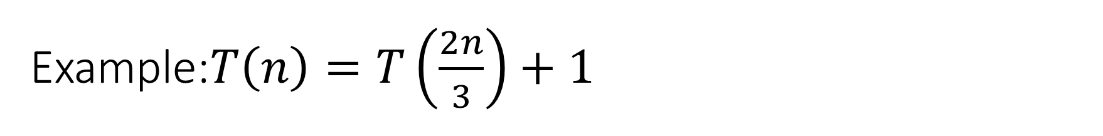
Example:$T\left(n\right)=T\left(\frac{2n}{3}\right)+1$
$a=1,b=\frac{2}{3},f\left(n\right)=1$
$n^{\log_{b}{a}}=$ $n^{\log_{\frac{2}{3}}{1}}=$ $n^{0}=1$
$f\left(n\right)=1=Θ\left(n^{\log_{\frac{2}{3}}{1}}\right)=Θ(1)$
$⇒$ $T\left(n\right)=$ $Θ(lgn)$ by case 2

Slide 36
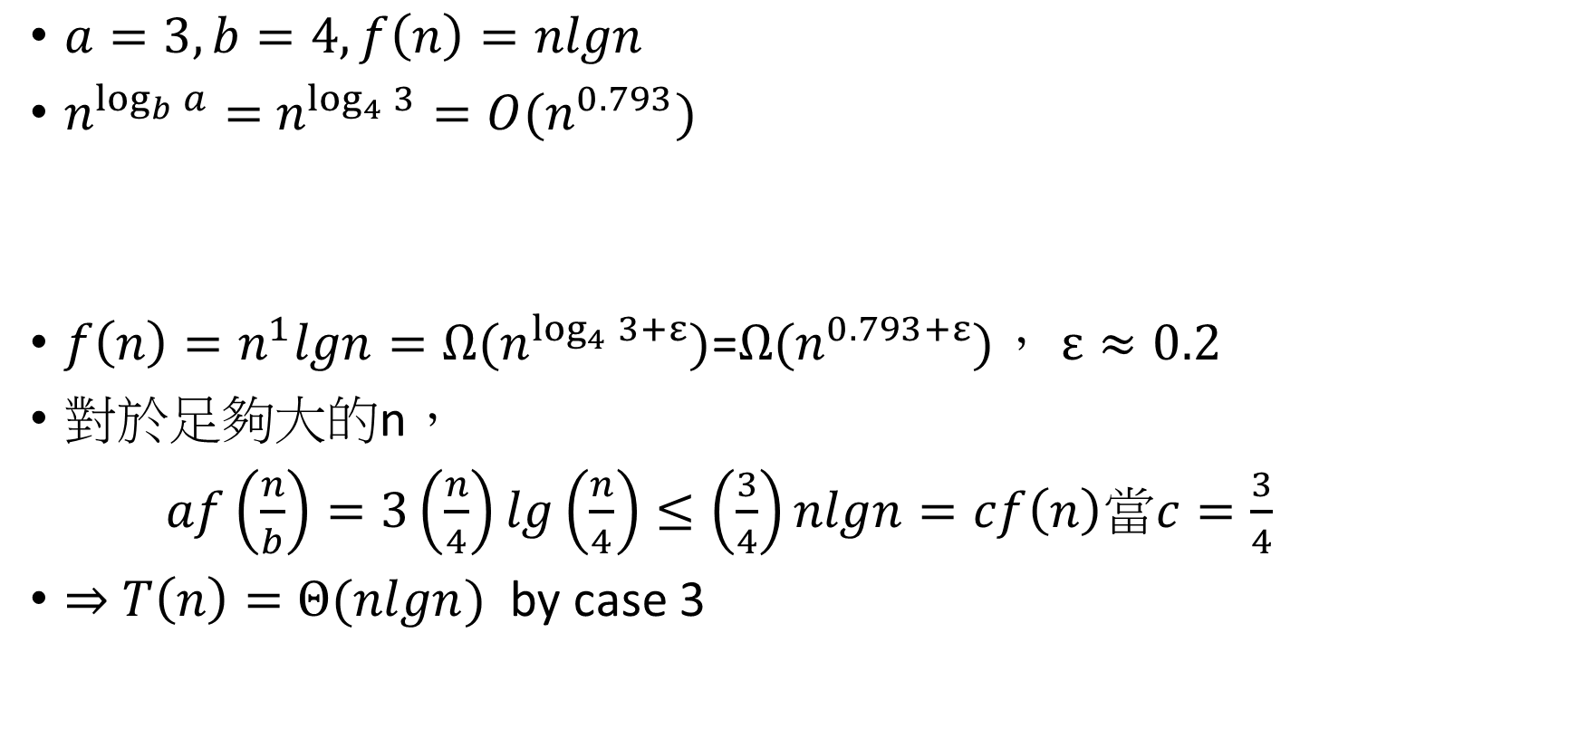
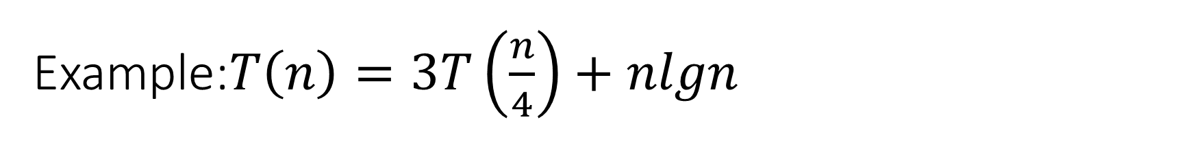
Example:$T\left(n\right)=3T\left(\frac{n}{4}\right)+nlgn$
$a=3,b=4,f\left(n\right)=nlgn$
$n^{\log_{b}{a}}=$ $n^{\log_{4}{3}}=O(n^{0.793})$
$f\left(n\right)=n^{1}lgn=Ω(n^{\log_{4}{3}+ε})$=$Ω(n^{0.793+ε})$， $ε≈0.2$
對於足夠大的n，
$af\left(\frac{n}{b}\right)=3\left(\frac{n}{4}\right)lg\left(\frac{n}{4}\right)≤\left(\frac{3}{4}\right)nlgn=cf\left(n\right)$當$c=\frac{3}{4}$
$⇒$ $T\left(n\right)=$ $Θ(nlgn)$ by case 3

Slide 37


Example:$T\left(n\right)=2T\left(\frac{n}{2}\right)+nlgn$
$a=2,b=2,f\left(n\right)=nlgn$
$n^{\log_{b}{a}}=$ $n^{\log_{2}{2}}=$ $Θ(n^{1})$
$f\left(n\right)=nlgn=O(n^{\log_{2}{2}−ε})$
$\frac{f(n)}{n^{\log_{b}{a}}}= \frac{nlgn}{n}=lgn=O(n^{ε})$ $，$ $ε$=?
因為$nlgn$與$n$沒有差距” polynomially”，主定理不適用
$lgn無法表示為n^{ε}$
利用Extension of Master Theorem解決
$T\left(n\right)=$ $Θ\left(n^{\log_{b}{a}}\log^{k+1}n\right)=Θ\left(n\log^{2}n\right)$

Slide 38
Thank you

